Slide 1
Secure data hiding in images using Stegnography
CAPSTONE PROJECT
Presented By:
Student Name : K U Nischitha
College Name & Department : Parivarthana Business School
Master of computer Application

Slide 2
OUTLINE
Problem Statement
Technology used
Wow factor
End users
Result
Conclusion
Git-hub Link
Future scope

Slide 3
Problem Statement
Stegnography a technology of hiding secret data within,images,has emerged potential solution.Therefore developing a secure and robust image stegnography method that can withstand detection and ensure confidentiallity is essentail.This project aims to design and implement such a method to ensure confidentaillity and integrity of sensitive information.

Slide 4
Technology used
Libaries used:
Open cv-Computer vision library for image processing
OS-It is used to acces environment variables
String-It provides a set of useful constants and classes
Platform
Python 3.13

Slide 5
Wow factors
Some of the unique features about this projects are:
Image quality Preservation :As it dosenot affect the quality of the image
Variable data types: Stegnography can hide various types of data,including images,audio and video
Invisible data:Hidden data is invisible to the human eye,making it difficult to detect.
High Security:Data is hidden in a way that makes it undetectable to unautorized parties.
Multi-Image support:This project supports hiding data in muiltple images,making it suitable for applications that require hiding large amounts of data

Slide 6
End users
Goverment organizations:they require secure communication and data sharing,such as law enforcement or military organizations.
Financial Institutions:Banks and financial insttituions that need to securely share financial data or transactions
Healthcare organizations:Healthcare providers that need to securely share patient data or medical records

Slide 7
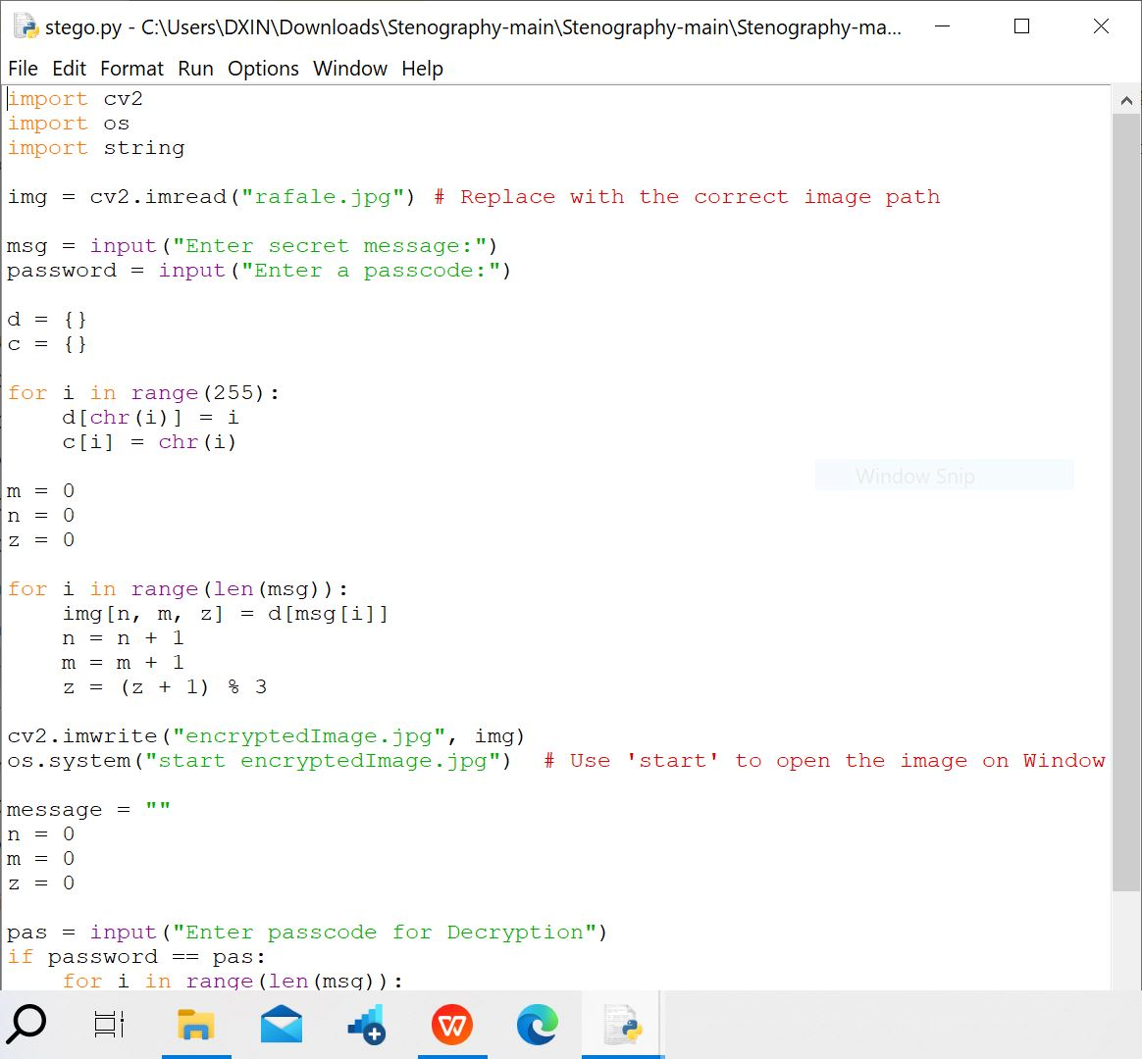
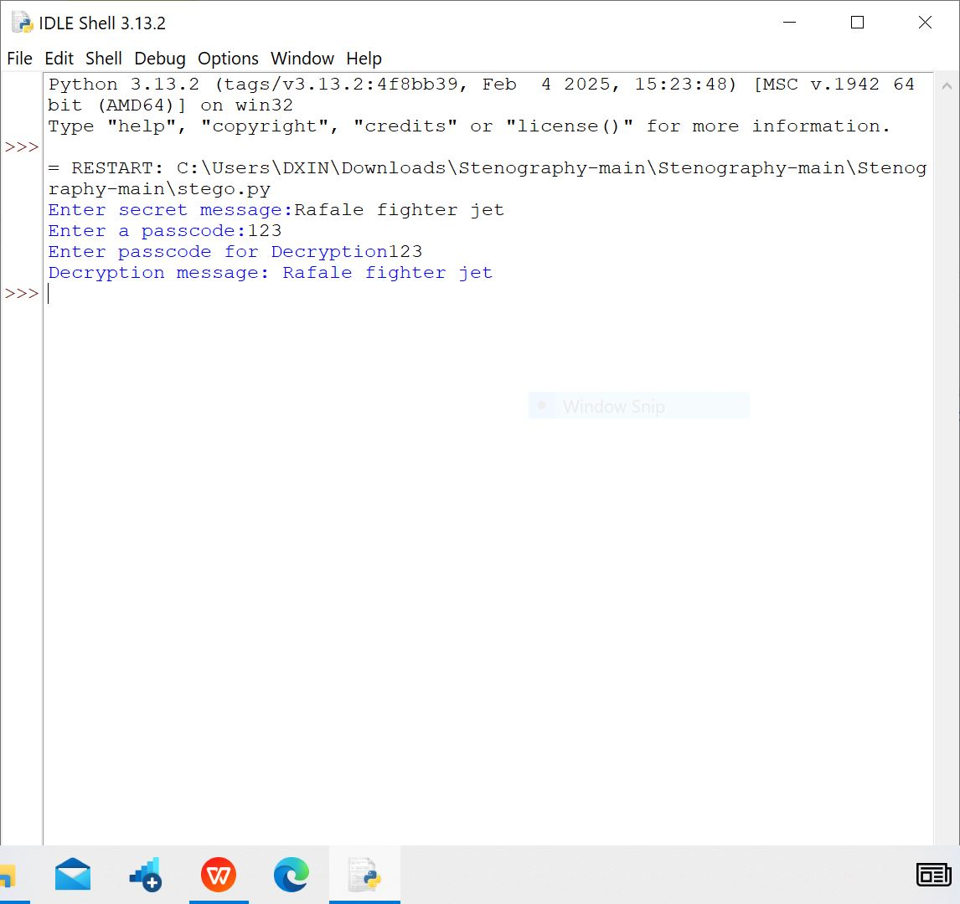
Results

Slide 8
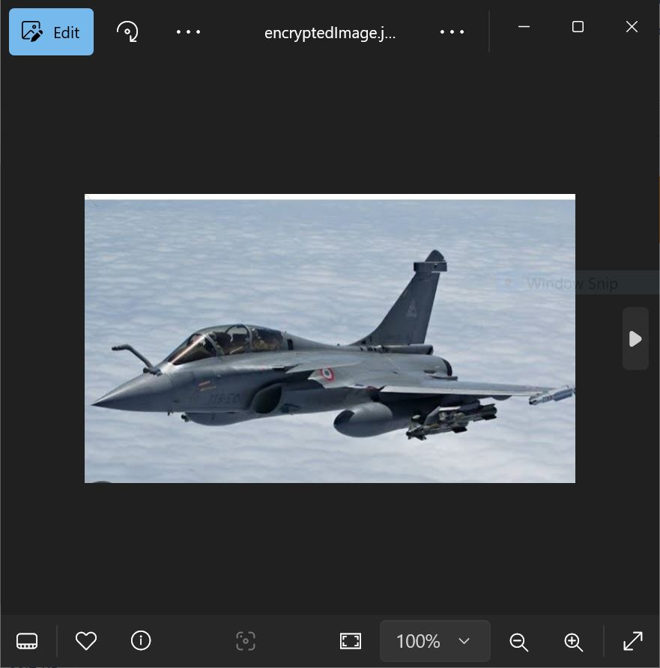

Slide 9
Conclusion
Image hiding using stegnography is a powerful technique for secure data transmission.Its high security,invisibility,and high security ,invsibility,and high capacity make it an attractive solution for various applicationsand it provides a secure way to communicate sensitive information.

Slide 10
GitHub Link
https://github.com/Nischithaku/myaicteproject.git

Slide 11
Future scope(optional)
Digital Watermarking:It may be used in digital and watermarking protection
Biometric data Protection:For protecting fingerprints and facial recognition daa.
Medical Image Security:Exploring the use of stegnography for securing medical images and patient data
Deep Learning-Based Stegnography:Techniques that can withstand with a sophisticated attacks.

Slide 12
THANK YOU

